Slide 1
CART FUEL
Team Anonymous Assembly

Slide 2
Team
Frontend Team:
Hari Sai Raghuram Veeramallu
Akhilesh Pothuri
Backend Team:
Rithvik Sallaram
Ashwin S

Slide 3
Problem Statement
Users abandon their carts after adding items to it due to many reasons. Reasons vary from a higher total bill than estimated to bad or robotic user interface design.
Predict if a user browsing through the website will eventually make a purchase or not and consequently take necessary steps to try to reduce the chances of abandonment.
How can we retain customers on our website, without enticing them with offers and discounts.

Slide 4
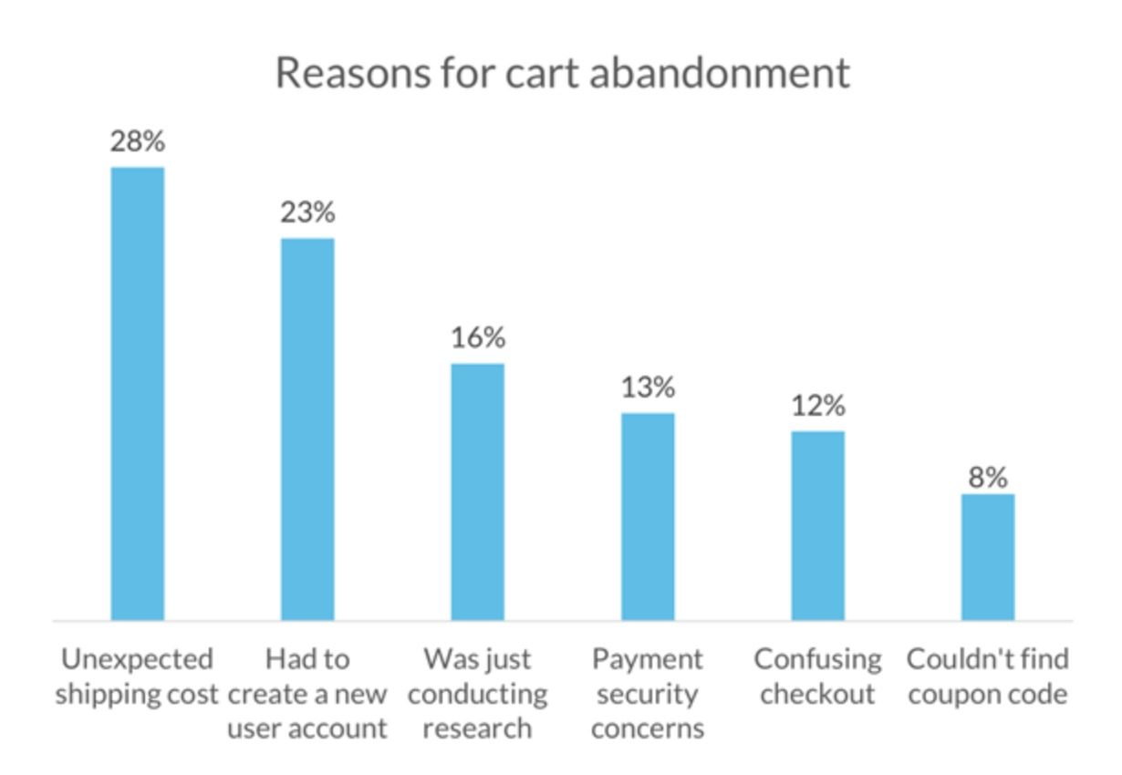
User Research

Slide 5
Proposed Solution
SPARS : (SMART PRODUCT ANALYTICS REPORTING SYSTEM)
In Session Analytics
Out Session Analytics
Session Analytics to predict the cart abandonment by the user.
Inform the users about the products in the cart and show some good reviews about the product to them to reduce the rate of cart abandonment.

Slide 6
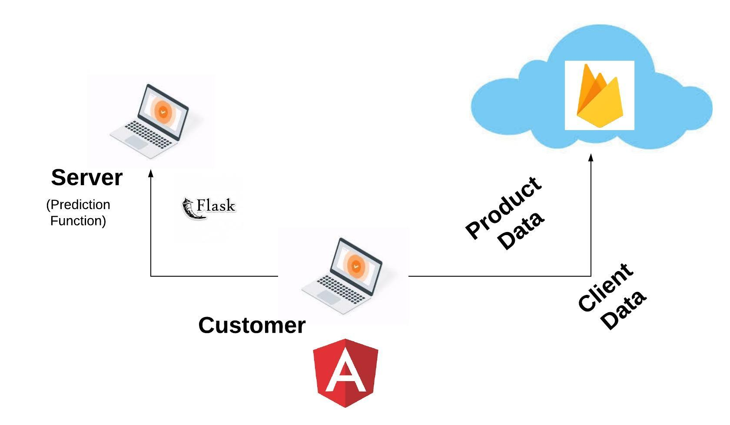
Product Architecture

Slide 7
Data and feature extraction
Dataset consists of actual user activity with 1 million rows of user click patterns grouped based on a session.
Best Subset of features chosen among all the features to give prediction whether a person ultimately buys a product in that session.
Session ID | Timestamp | Product ID | Bought (0/1) | Number of Clicks in that session

Slide 8
ML model
Features selected :
Number of unique products clicked in the session
Total number of valid clicks made in that session
Libraries used : scikit learn

Slide 9
Smart Recommendation Engine
Product
Week no.
Sunday
Monday
Work Hours
Off Hours
Others

Slide 10
Tech Stack
User interface : Angular
Backend server : Flask
Cloud services : Firebase
Data Set cleaning and extraction : Python Pandas
ML model : Scikit learn

Slide 11
Future Scope
A fluid user interface for effortless UI transitions.
Outsession Solutions.
AI Chat bot to make sure customer’s concerns are heard.
Provide product recommendations to user in case of cart abandonment.
Our own Analytics Dashboard for User Behaviour Tracking.

